Slide 1
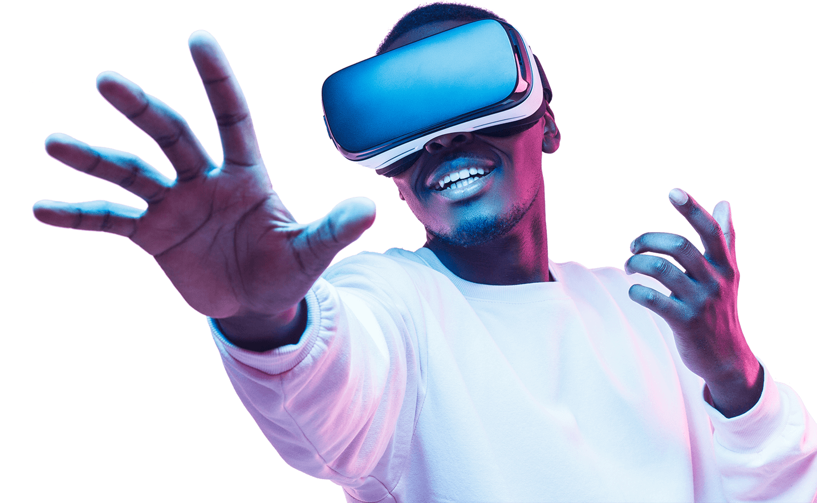
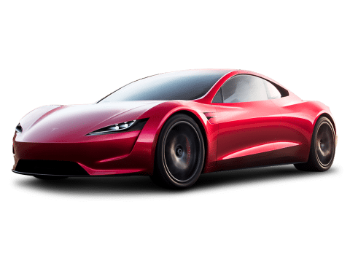
Driver Attentiveness in Virtual Reality
Professional Project (COM3001)
Student: James Wright
Supervisor: Dr. Steve Wesemeyer

Slide 2
Project Aim
The aim of the project is to investigate how different scenarios can positively or negatively effect a driver’s reaction time whilst driving a car.
Short-Term Goal: Give reliable information into which technologies (current or new) aid or distract drivers.
Long-Term Goal: Help to push government regulations, inspire companies/entrepreneurs to create new technologies, ultimately - reduce road deaths.
Notes:
Aim: Find out what affects a driver positively or negatively. Produce reliable information on this in the short term & help push regulations in the future.

Slide 3
Background knowledge

Slide 4
Literature Review: Road Accidents & Fatalities
On average, in Great Britain, 5 people die per day on the road and many more are injured. With the majority of the fatally injured being drivers & passengers [1].
Risk perception of the driver is a key factor in whether they will crash or not, independent of driver skill [6] – implying driving skill is not a significant factor, the overconfidence of a driver is.
Speeding and Distractions make up nearly 50% of the named causes for road fatalities [2].
Notes:
Main points on road accidents: 5 people die per day on the road in Great Britain, Driver’s skill not a huge factor instead risk perception based on their skill is, speeding and distractions account for half of the causes for road deaths.

Slide 5
Literature Review: Driving Distractions
Programming a mounted Sat Nav whilst driving (programming route or following directions) has been shown to distract the driver, it is currently legal in the UK too [13] hence it would benefit from being studied to see if it has significant negative effects.
It is also hypothesised that even following visual directions from a Sat Nav whilst driving can be dangerous too [13].
Handsfree phones and filming on a phone whilst driving are also legal in the UK [13] and are linked to driving accidents.
Study [14] has shown that loud music in the car (above 95 decibels) can slow driver reaction times by 20%, also teenagers likely to have music this loud.
Notes:
Main points on distractions whilst driving: programming or following a mounted sat nav’s direction whilst driving could be dangerous, handsfree phones & filming on phones also linked to accidents, as well as a study showing that loud music reduces driver reaction times significantly too. All of these are LEGAL as well, which is perfect for this project to focus on.

Slide 6
Literature Review: Driving Aids
Long-term fixes to this problem: Brain to Vehicle Technology [16], Automated Braking [17], Self-Driving Car Technology [18]; are all being researched and some are in cars to varying degrees – however these technologies could take decades to be perfected and commonplace.
Short-term aid would help to reduce deaths in the meantime.
Humans react to auditory stimulus a significant amount faster than visual stimulus [21], hence a good short-term solution that I could test would be to give an auditory alert whenever the car is in a dangerous situation. If the technology is successful then research could be done by others as to how to implement this feature in real life (Object recognition/detection algorithms, etc.)
Notes:
Main points on potential driving aids: lots of new technology being developed or implemented in cars (brain to vehicle, automated braking, self-driving cars) but will take time to be common in every car and be at the level needed to fix this problem. Room for a potential simple – cost effective - short term solution in the meantime. It has been well documented that humans react to sounds quicker than a visual stimulus, hence I decided to come up with an idea based on that concept. An auditory alert that occurs when detecting danger (car slowing down in front of you at a rapid rate) is a simple idea, as the technology is basically already there with automatic braking, so it’s just a cost-effective version (if it actually helps)

Slide 7
Literature Review: Virtual Reality
Maximum of 30 minutes of Virtual Reality simulation per person recommended to minimise motion sickness [8] as well as regular breaks – a minute break per scenes should be fine (unless the user wants more time or wants to stop the test completely). – Ethical concerns if a tester gets sick.
“a virtual emergency can be staged in a virtual environment since users would acknowledge it as such” [10] – this study adds credibility that the results from my experiment will be reliable, as they conclude that users treat virtual situations seriously. Hence, they will try and react correctly & as fast as possible in a “dangerous” situation (car accident in this context).
Notes:
Main points on virtual reality: motion sickness can easily occur if measures are not taken (regular breaks, no sudden/sharp movements, slow pace) – could create ethical concerns if a human tester gets sick, there have been many studies in the past using virtual reality to mimic reality as well as a particular study that had users simulate being a firefighter (trying to save lives) and they concluded that the participants do treat the situations seriously and act as they would in real life – which adds a lot of credibility to the results I obtain.

Slide 8
Literature Review: References Included in Presentation
[1] https://www.brake.org.uk/facts-resources/1653-uk-road-casualties - Brake UK 2017 report on road casualties.
[2] https://www.aceable.com/safe-driving/car-accident-statistics/ - Aceable US driving fatality data (2007 – 2012).
[6] https://www.sciencedirect.com/science/article/pii/S0001457513003497?via%3Dihub - Accident Analysis & Prevention (Volume 62, January 2014, Pages 63-78)
[8] https://www.businessinsider.com/virtual-reality-vr-side-effects-2018-3?r=US&IR=T#loss-of-spatial-awareness-1 – Business Insider “Here's what happens to your body when you've been in virtual reality for too long” by Kaylee Fagan (Mar 4, 2018, 4:00 PM)
[10] https://www.sciencedirect.com/science/article/pii/S0747563215000540?via%3Dihub - Computers in Human Behavior (Volume 48, July 2015, Pages 104-113)
[13] https://inews.co.uk/inews-lifestyle/cars/mobile-phone-driving-law-changes-explained-uk-new-legislation-824749#:~:targetText=At%20the%20moment,%20using%20a,nav%20while%20driving%20is%20illegal.&targetText=You're%20able%20to%20use,in%20these%20cases%20is%20illegal. – UK Mobile Phone Laws Whilst Driving
[14] https://www.idrivesafely.com/defensive-driving/trending/7-deadly-sins-distracted-driving-wrath-music - Music Whilst Driving Affecting Reaction Times (Newfoundland’s Memorial University study & Ben-Gurion University in Israel study)
[16] https://roadsafetygb.org.uk/news/brain-to-vehicle-technology-will-speed-up-reaction-times-nissan/ - Nissan Brain to Vehicle Technology (Article by RoadSafetyGB)
[17] https://mycardoeswhat.org/safety-features/automatic-braking/ - Automatic Braking explained (Article by MyCarDoesWhat.org)
[18] https://www.fool.com/investing/2017/10/22/how-far-along-is-self-driving-car-technology-reall.aspx - Self-Driving Cars Progress (Article by John Rosevear, Oct 22, 2017 at 7:05AM)
[21] https://www.sciencedirect.com/science/article/pii/000169188490043X - Visual and auditory choice reaction times (Acta Psychologica: Volume 55, Issue 3, May 1984, Pages 231-247)
Notes:
References included in the presentation (more sources and points covered in main literature review document)

Slide 9
Development Work

Slide 10
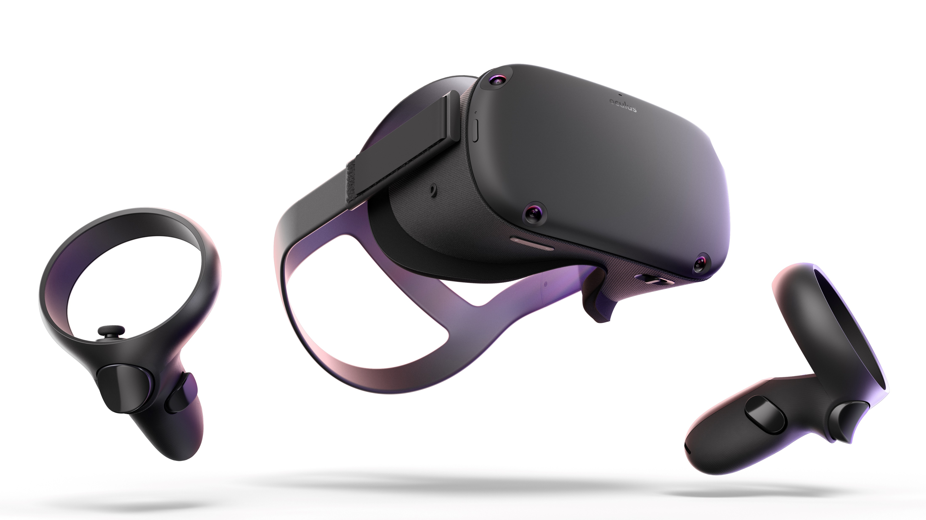


Receives user input & calculates result, outputs results to a local file (encrypted)
Exports application to the oculus device
User inputs button press in reaction to stimuli
Oculus Quest (VR)
Runs application
Screen records the user’s test
Transfers data from oculus (results & screen recordings) to the computer
User
Development Software
Gives written & verbal consent to do test and to use their data
Tells the user the instructions, and explains the test
Programs the application in unity
Fills out feedback form & gives to developer
Developer (Me)
Notes:
Simple diagram showing the basic functionality and relationship between different parts of the project. A more detailed one can be done in the future (Use case diagram) this is just to demonstrate the basic timeline of how things will be working. The screen recording may be changed to streaming so that I can view what the user’s are doing during the test and after as well, rather than just afterwards, but I am still doing tests with that to see if it is potentially viable.

Slide 11
Data Output from Testing
Data 1: User reaction time (float value) to the car emergency stopping.
Data 2: Boolean value (true/false) on if the user would have crashed into the car or not, based on stopping distance & the user reaction time.
Data 3: Boolean value (true/false) on if the user pressed the button before the trigger occurred (pre-emptive response) – essentially a fail statement in which case data 1 & 2 will be void.
Data 4: Screen recording of each test.
Data 5: Test feedback form (Questionnaire with 1 to 5 rating for each question).
Data 6: Demographic data from form (age, sex, race, work, relationship status, etc.) if the user gives consent to giving us their data.
Notes:
Key data that will be received from the tests: reaction time, would they of crashed?, did they fail the objective (press button before trigger appeared), screen recording, feedback form (questionnaire), and demographic data (main thing being focused on is age due to loud music study quoting teenagers to be affected by this, so I can add some questions on the questionnaire about whether they listen to loud music while driving, etc.)

Slide 12
Scenes: Calibration Scene
What:
Press the button as quickly as you can when a light in the virtual room turns green.
Why:
To get a control time for each of the user’s reaction time, something to compare the rest of the user’s results to. This also teaches the user the basic input needed for the actual test, as it will be the exact same controls and mechanisms.
How:
Occurs at the very start of the test, the user gets 3 attempts & the average is taken from the 3 attempts.
Notes:
Calibration/Control scene, to get a basic control value for each user so that I can compare the users results in the following scenarios with this control value (as each user will have a different base reaction time).

Slide 13

CALIBRATION SCENE
Basic version of this test developed and built.
UI (User Interface) and 3D models/environment to be improved in the future.
Displays average - calculated by [total/n] (where n is the total number of attempts).
*might change average to the median (middle number) to account for human error (not knowing how it works the first time, etc.)*
Notes:
Basic version of the calibration/control scene already developed in unity, visuals and user interface will be improved, and I will probably change the average to the median (middle number) to avoid human error weighing the average down (forgetting to press the button one time, or not understanding how it works).

Slide 14
Scenes: Basic Class Diagram
Notes:
Basic class diagram, subject to change and does not include the driving variables (distractions) as they will be random for each scene. I will develop a separate class diagram for each of the other objects/classes (sat nav class, following directions methods/inputs, etc.)

Slide 15

Scenes: Scene 1
Scenario:
The car in front of the driver suddenly emergency stops.
Driving Variables:
Programming a location into a Sat Nav on a mounted display.
Following Sat Nav instructions on a mounted display.
Loud music in car (over 95 decibels).
Loud auditory alert for when an emergency stop is needed.
*variables are randomised over the 3 scenes*
Notes:
Car emergency stops in front of you after a specified amount of time, the user has to react quickly (button press is the equivalent of slamming on the brakes fully until stopped) – will have to research stopping distance calculations for this.

Slide 16
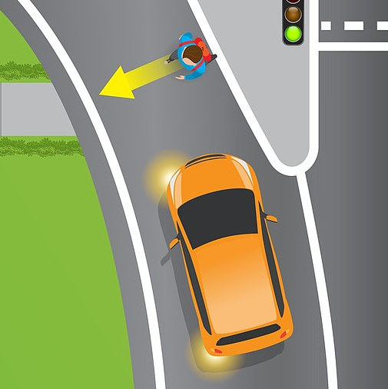
Scenes: Scene 2
Scenario:
Pedestrian crosses the road (not at a suitable crossing), directly in front of the car.
Driving Variables:
Programming a location into a Sat Nav on a mounted display.
Following Sat Nav instructions on a mounted display.
Loud music in car (over 95 decibels).
Loud auditory alert for when an emergency stop is needed.
*variables are randomised over the 3 scenes*
Notes:
Pedestrian walks across the road without looking, not at a pedestrian crossing, hence the user will have to react quickly to emergency stop (same as scene 1)

Slide 17

Scenes: Scene 3
Scenario:
Traffic light turns red as the driver approaches it.
Driving Variables:
Programming a location into a Sat Nav on a mounted display.
Following Sat Nav instructions on a mounted display.
Loud music in car (over 95 decibels).
Loud auditory alert for when an emergency stop is needed.
*variables are randomised over the 3 scenes*
Notes:
Traffic light turns orange then red as the driver approaches it, if they do not realise it is changing and stop in time then they will pass through the red light (which is a fail) – all these scenes use emergency stopping because that is a reliable scenario for getting reaction time data and crash/fail data. The driving variables (programming a location into the sat nav) will be the more difficult things for the users to do, with the scenes being fairly simple, similar to each other and straightforward so that they should each have similar base reaction times (can focus mainly on the driving variables affecting results).

Slide 18
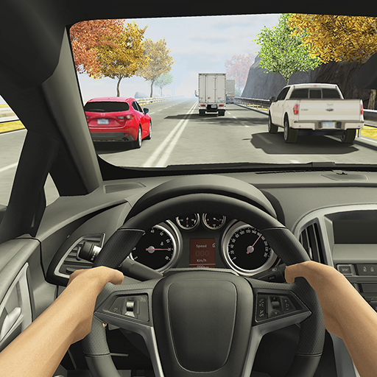
Example of the User’s View
First person view
Cockpit of car
Road environment
UK roads/cars unlike this image (E.g. left side of the road, wheel on right side of the car, etc.)
Image source: “Racing in Car 2” screenshot
https://play.google.com/store/apps/details?id=com.ffgames.racingincar2&hl=en
Notes:
Basic example of what the user will see in VR, taken from a game on the google play store.

Slide 19


Software
GitHub: (Free Version)
For file management, version control, and backups.
Unity 3D: (Free Version)
For creating & scripting 3d environments & scenes – the main application.
Autodesk Maya: (Student Version - Free)
For creating realistic 3D models that can be textured, animated, & used as an asset within unity. It is industry standard.
Notes:
Software being used: mainly github and unity, maya will be used for simple 3D objects when possible and online models (with permission) will be utilised for everything else.

Slide 20
Planning

Slide 21
Project Objectives
Become skilled and experienced using Unity in a 3D environment.
Learn how to program for Virtual Reality hardware.
Have a successful experiment, where at least 10 different people are tested & sufficient reliable data is collected.
Research different literature & data for both real and simulated experiments in similar areas.
Learn basic 3D modelling in Maya (as it’s industry standard).
Stick to a schedule and complete tasks on time.
Notes:
Main project objectives…

Slide 22
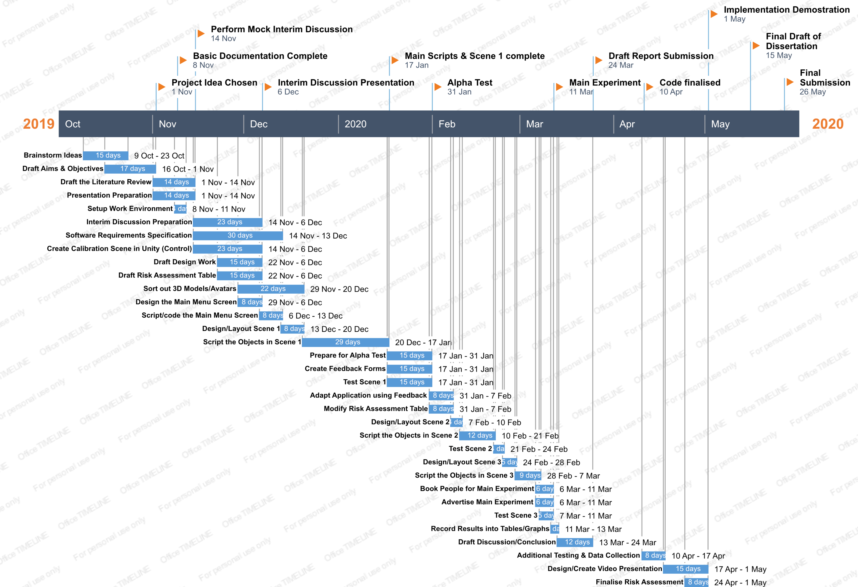
Tasks & Milestones
*image created using Office Timeline free web version*
Notes:
Tasks and milestones, made in excel and visualised in office timeline free version. Main points: menu, calibration scene, and scene 1 to be complete by 17th of January for alpha test at the end of January. Main experiment (with all 3 scenes and variables) to be completed on the 11th of march, allowing time to focus on organising and understanding data (discussion/concluding). Each scene has been given a time slot to be developed in, with the first scene taking the longest, this is because whilst making the first scene a lot of prefabs and scripts will be made that will be reusable for the other 2 scenes. Another thing to note is after the main experiment I have left a window of a month to make any other changes to the application that I think could be helpful to test in a 3rd experiment (new distractions or refining scenes, etc.)

Slide 23
Progress So Far:
Setup Unity Project with GitHub (made sure only the appropriate files are committed too).
Drafts of Aims, Objectives, and Literature Review completed.
Milestones and timeline complete (plus to-do list for specific tasks).
Major design decisions done (Scenes, Driving variables, Inputs, Class Diagrams, Data Collection, etc.)
References for literature and for code (so far) recorded within documents.
Calibration (control) scene programmed, with only UI and visual improvements needed.
Notes:
Progress so far…

Slide 24

Thank you for listening! Any Questions?

